Slide 1

Data Visualization
NUS-MIT DATATHON 2018
David Sasson
M.S. Candidate, Health Data Science
http://davidsasson.info/

Slide 2
Today
What is Data Viz?
10 Commandments of Data Viz
Introduction to ggplot2
Application to MIMIC / Health Data Viz
Practice Problems (time permitting)

Slide 3
What is Data Visualization?
a method of encoding quantitative, relational, or spatial information into images
taps into the visual system – an enormously powerful pattern-finding device – which can reveal structure in data in a compelling and accessible way

Slide 4
Why do we need it?
Visualization is an important means of understanding data
effective visualizations can improve comprehension and often do so more quickly than other methods
It’s difficult hard to get a good idea of trends and patterns
Some statistical methods are designed to summarize your data in various ways
mean, median, standard deviation, etc.
But sometimes it's just nice to be able to "see" hundreds or thousands of raw data points all at once, without any summary statistics.

Slide 5
Why do we need Health Data Viz?
As data has grown, particularly in the clinical domain, visualization has become increasingly important for the purposes of presentation and exploration
As a presentation tool, well-chosen visual representations can
help engage readers
reduce the effort required to understand work.
As a tool for exploration, a few simple visualizations can go a long way toward
understanding what your data "looks" like
what biases it may contain
and how best to proceed with exploratory analyses.

Slide 6
Understand your audience
Graphs can be used for
our own exploratory data analysis
should be easy, quick, and informative
little details like the aesthetics of the overall image are less important
to convey a message to experts.
example: when performing regression, using a Q-Q plot to assess homoscedastic residuals
to help tell a story to a general audience
These are designed to convey specific information about some data in order to support some view.
Although data can seem objective, the way you present such information is extremely subjective!

Slide 7
Caveat
The key to a good visualization is that it lets the data speak for itself
The addition of extra fluff (shadows, 3D, extravagant colors) eclipses what the graph is actually showing
A good visualization is minimal
It is also faithful to the data, and doesn't misrepresent it by modifying axes or colors the wrong way.
Data visualization is as much of an art as it is a science.

Slide 8
The 10 Commandments of Data Viz
Do
Don’t
Use the full axis
Simplify less important information
Be creative with legends and labels
Utilize a hierarchy
Ask others for opinions
Use 3D effects
Use more than six colors
Change visual style
Make people do visual math
Overload the chart

Slide 9
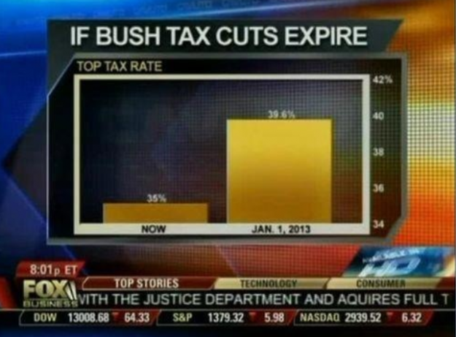
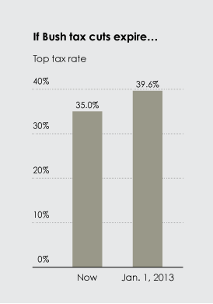
Do use the full axis
Avoid Distortion!
For bar charts, the numerical axis (often the y axis) must start at zero.
Our eyes are very sensitive to the area of bars, and we draw inaccurate conclusions when those bars are truncated.

Slide 10
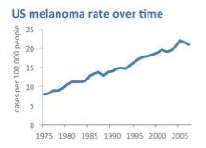
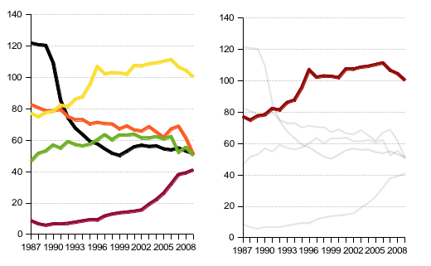
Do simplify less important information
Chart elements like gridlines, axis labels, colors, etc. can all be simplified to highlight what is most relevant.
You may be able to eliminate gridlines or reserve colors for isolating individual data series and not for differentiating between all of the series being presented

Slide 11
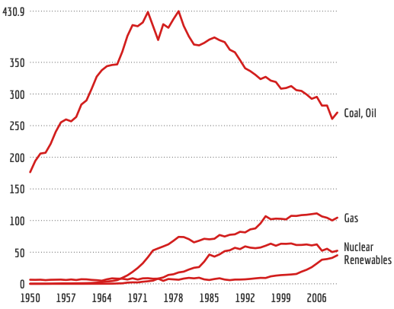
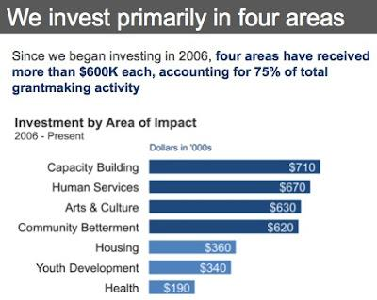
Do be creative with your legends and labels
Some Possibilities:
Label lines individually
Rotate bars if the category names are long
Put value labels on bars to preserve the clean lines of the bar lengths

Slide 12
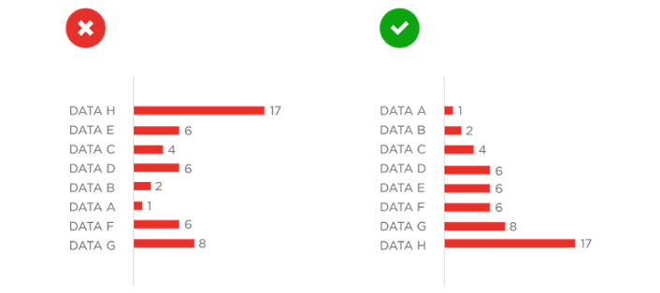
Do utilize a hierarchy
For all charts, make sure the data is organized and intuitive. Consider ordering all data alphabetically, by value or sequence.

Slide 13
Do ask others for opinions
Even if you don’t run a full usability test for your charts, have a fresh set of eyes look at what you’ve done and give you feedback.
You may be surprised by what is confusing to others.

Slide 14
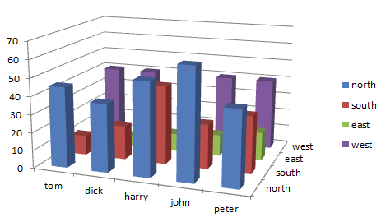
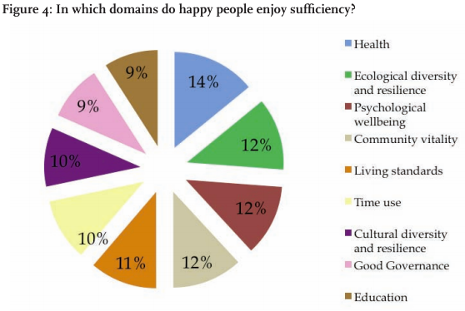
Don’t use 3D effects
Studies show that 3D effects reduce comprehension
Blow apart effects make it hard to compare elements and judge areas

Slide 15
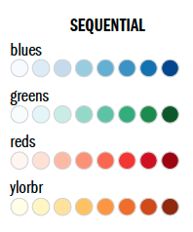
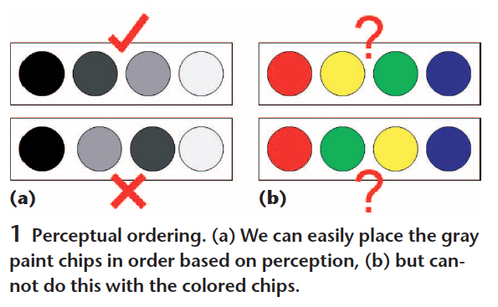
Don't use more than (about) six colors.
Using color categories that are relatively universal makes it easier to see differences between colors.
The more colors you need, the harder it is to do this.
But different colors should be used for different categories (e.g., male/female), not different values in a range (e.g., age, temperature).
If you want color to show a numerical value, use a range that goes from white to a highly saturated
Some people have color blindness.

Slide 16
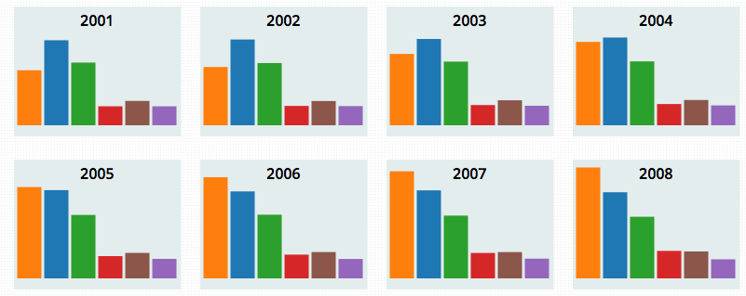
Don’t change style midway
Comparison is critical, and our visual system can detect anomalies in patterns
Try keeping chart styles consistent across a series so differences can be seen

Slide 17
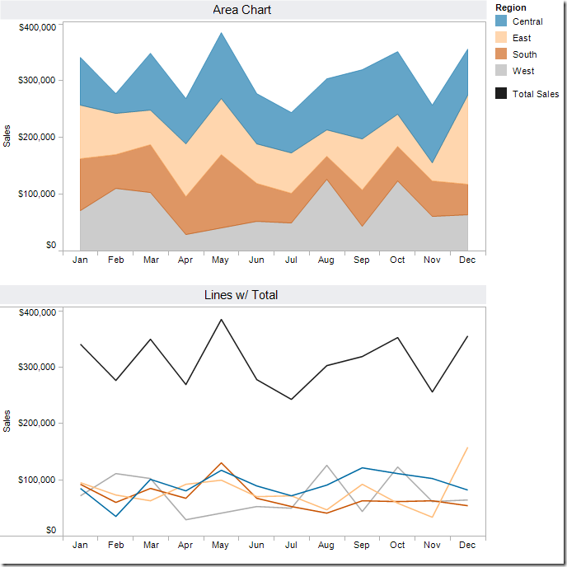
Don’t make people do “visual math”
If the chart makes it hard to understand an important relationship between variables, do the extra calculation and visualize that as well.
Our visual processing system is not well suited to comparing these types of visual areas.

Slide 18
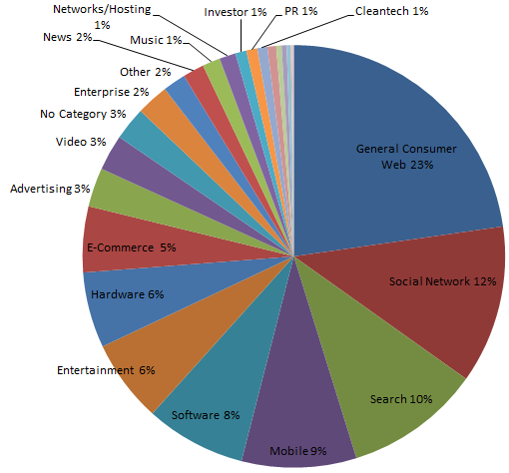
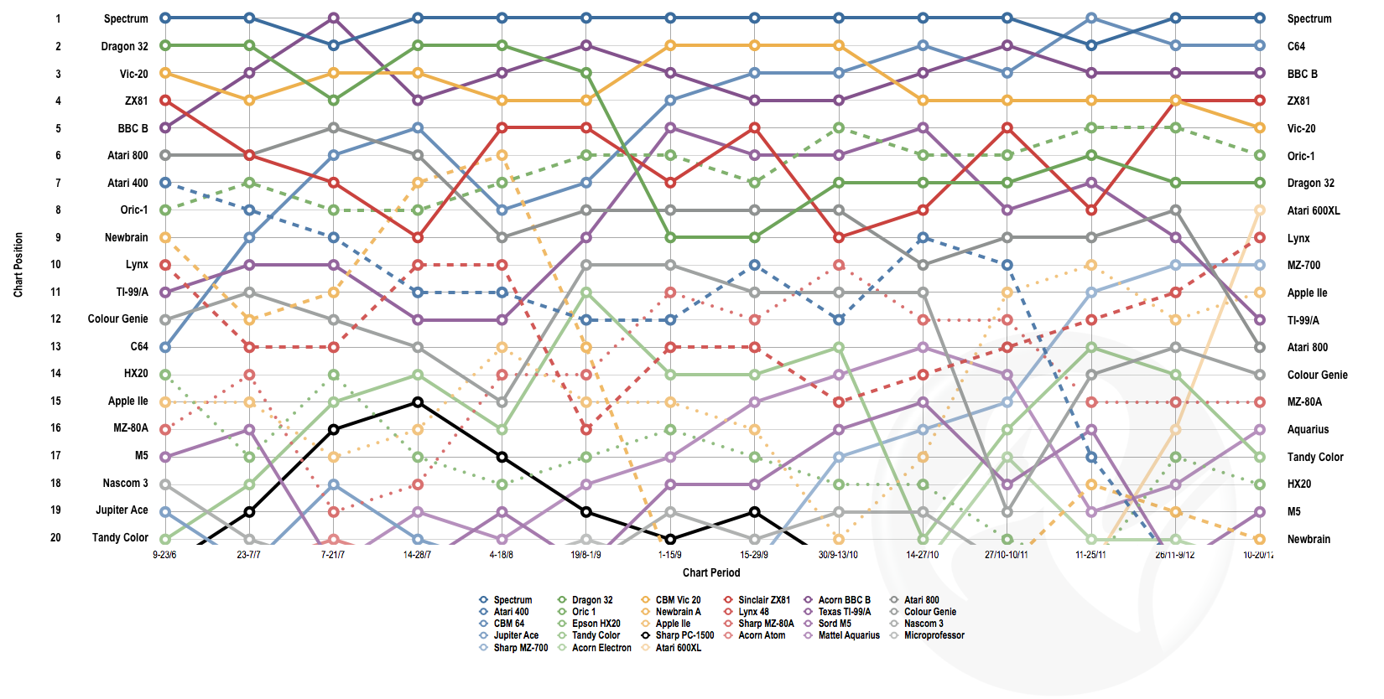
Don’t overload the chart

Slide 19
Introduction to ggplot2
github.com/dsasson48/dataviz
goo.gl/GXQUbz
You should have R (http://cran.r-project.org), RStudio (http://rstudio.com), and MIMIC (http://mimic.physionet.org/) installed.
THERE ARE NO DUMB QUESTIONS—PLEASE ASK TO MAKE THIS A FUN WORKSHOP ☺

